Slide 1
.NET Framework

Slide 2
Objectives
In this session, you will learn to:
Identify the components of the .NET Framework
Understand the Visual Studio .NET IDE

Slide 3
Identifying the Components of the .NET Framework
What is the .NET Framework?

Slide 4
Identifying the Components of the .NET Framework
Microsoft introduced the .NET Framework to make applications more interoperable.
Interoperability of applications means the ability of applications, developed in different languages, to be able to work together and exchange information with each other.
The objective of .NET framework is to bring various programming languages and services together.

Slide 5
Identifying the Components of the .NET Framework
The .NET Framework is designed to make significant improvements in:
Code reusability
Code specialization
Resource management
Multi-language development
Application security
Application deployment
Application administration
Notes:
5

Slide 6
Identifying the Components of the .NET Framework
The. NET Framework consists of all the technologies that help in creating and running applications that are:
Robust: Applications those are strong.
Scalable: Applications that can be extended.
Distributed: Applications that runs on computers of different networks.
The .NET offers a complete suite for developing and deploying applications. This suite consists of:
.NET Products
.NET Services
.NET Framework

Slide 7
Components of the .NET Framework
What are the components of the .NET Framework?

Slide 8
Components of the .NET Framework
The .NET Framework consists of the following components:
Common Language Runtime
.NET Framework Base Classes
User and program interfaces
Let us understand Common Language Runtime (CLR).

Slide 9
Components of the .NET Framework
Common Language Runtime (CLR):
Is the environment where all programs using .NET technologies are executed.
Provides services such as code compilation, memory allocation, and garbage collection.
Allows the execution of code across different platforms by translating code into Intermediate Language (IL).
IL is a low level language that the CLR understands.
IL is converted into machine language during execution by the Just-In-Time compiler.
During JIT compilation, code is also checked for type safety.
Notes:
9

Slide 10
Components of the .NET Framework
Common Language Runtime
Low level language is converted into machine language
by the Just-In-Time compiler
Just-In-Time Compiler

Slide 11
Components of the .NET Framework
CLR consists of a set of common rules followed by all the languages of the .NET Framework. This set of rules is known as Common Language Specification (CLS).
CLS enables an object or application to interact with the objects or applications of other languages.
One of the specifications defined in CLS is Common Type System (CTS), which provides a type system that is common across all languages.
CTS defines how data types are declared, used, and managed in the code at run time.
Notes:
11

Slide 12
Components of the .NET Framework
Common Language Runtime
Just-In-Time Compiler
CLS enables an object or application to interact with the objects or applications of other languages.
Common Language Specification
Common Type System

Slide 13
Components of the .NET Framework
Common Language Runtime
Just-In-Time Compiler
Common Language Specification
CTS defines how data types are declared, used, and managed in the code at run time.
Common Type System

Slide 14
Components of the .NET Framework
Compilation is the process of creating an executable program from a source code.
When you compile a program in .NET, the conversion of source code to machine language happens in two stages.
In the first stage, the compiler translates code into an IL instead of machine language or assembly language.
In the second stage the conversion of IL to machine language is done at run time by the JIT compiler.
Notes:
14

Slide 15
Components of the .NET Framework
The following figure shows the process of code compilation.
IL
+
Metadata
Program Code
Compiler
Assembly
Notes:
15

Slide 16
Components of the .NET Framework
During execution, CLR performs the following tasks:
Loading assemblies and identifying namespaces
JIT compilation
Garbage collection
The code developed in .NET is called managed code.
The CLR manages the compilation and execution of the managed code to ensure proper functioning of the code.
An assembly contains IL and metadata that was generated during compilation.
Instead of compiling the complete IL code, the JIT compiler compiles only the code that is required during execution.
Notes:
16

Slide 17
Components of the .NET Framework
The .NET Framework Class Library:
Works with any .NET language, such as VB.NET, VC++ .NET, and VC#.
Provides classes that can be used in the code to accomplish a range of common programming tasks, such as string management, data collection, database connectivity, and file access.
Comprises namespaces, which are contained within assemblies.

Slide 18


Components of the .NET Framework
.NET Framework Class Library
Assembly
Namespaces help you to create logical groups of related classes and interfaces, which can be used by any language targeting the .NET Framework and are stored in assemblies.
Namespaces
Notes:
18

Slide 19
Components of the .NET Framework
.NET Framework Class Library
Assembly
An assembly is a single deployable unit that contains all the information about the implementation of classes, structures, and interfaces.

Slide 20
Components of the .NET Framework
User and Program Interfaces: At the presentation layer, .NET provides three types of user interfaces, which are:
Windows Forms
Web Forms
Console Applications
The .NET provides a program interface called, Web Services, to communicate with remote components.

Slide 21
Components of the .NET Framework
User and Program Interfaces
Windows Forms
These are used in Windows-based applications.
Web Forms
Console Applications

Slide 22
Components of the .NET Framework
User and Program Interfaces
Windows Forms
Web Forms
These are used in Web-based applications for providing an interactive user interface.
Console Applications

Slide 23
Components of the .NET Framework
User and Program Interfaces
Windows Forms
Web Forms
Console Applications
These are used to create
character-based console applications that can be executed from the command line.

Slide 24
Components of the .NET Framework
Some advantages offered by the .NET Framework are:
Consistent programming model
Multi-platform applications
Multi-language integration
Automatic resource management
Ease of deployment

Slide 25
Understanding Visual Studio .NET IDE
The Visual Studio .NET IDE provides you with a common interface for developing various kinds of projects for the .NET Framework.
The IDE also provides you with a centralized location for designing the user interface for an application, writing code, and compiling and debugging the application.
The Visual Studio .NET IDE is available to all the programmers who use languages in the Visual Studio .NET suite.

Slide 26
Creating Projects and Solutions
In Visual Studio .NET, an application can be made up of one or more items, such as files and folders.
To organize these items efficiently, Visual Studio .NET has provided the following two types of containers:
Project: Typically contains items that make up the application. These items are interrelated.
Solution: Usually acts as a container for one or more projects.

Slide 27
Creating Projects and Solutions
The following figure shows a solution containing multiple projects.
Solution
Project 1
Items
Project 1
Project 2
Project 2
Items
Miscellaneous Files

Slide 28
Creating Projects and Solutions
To create a console application in Visual Studio, you need to create a project.
To create a project, you need to perform the following steps:
Select Start → All Programs → Microsoft Visual Studio 2012 → Microsoft Visual Studio 2012. The Start Page - Microsoft Visual Studio window will be displayed.
Select File → New → Project. The New Project dialog box will be displayed.
In the New Project dialog box, select Visual C# from the Project Types pane and Console Application from the Templates pane.
Specify the name of the application in the Name text box.

Slide 29
Creating Projects and Solutions
5. Specify the location where the new project is to be created in the Location combo box. You can use the Browse button to browse to the folder in which the new project is to be created.
Click the OK button.
When you work with a console application project in Visual Studio .NET, you can use the following main elements in Visual Studio .NET IDE:
Solution Explorer window
Output window
Task List window
Class View window
Code Editor window

Slide 30
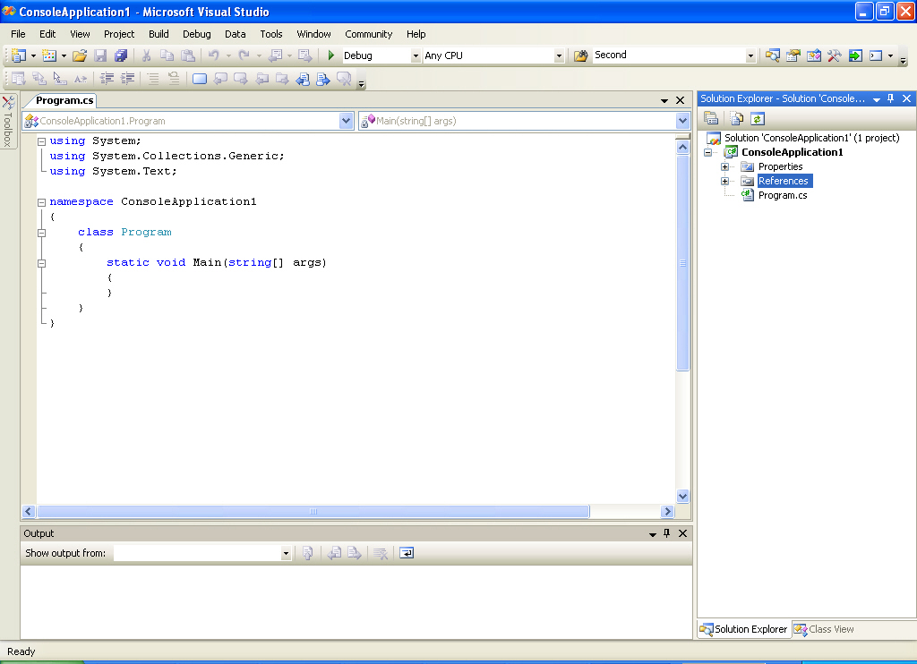
Creating Projects and Solutions
The following figure shows some elements of the Visual Studio .NET IDE.
Standard Toolbar
Solution Explorer Window
Code Editor
Output Window

Slide 31
Creating Projects and Solutions
The Standard toolbar is located below the menu bar and provides shortcuts for menu commands.
The first few buttons of the toolbar enable you to perform tasks common to many Windows-based programs, such as opening a new or an existing file, saving or printing a file, and cutting and pasting text and objects.
Notes:
31

Slide 32

Introducing the Microsoft .NET Framework 3.0

Slide 33

Agenda
Software Trends
.NET Framework 3.0 Tour
Getting the .NET Framework 3.0
Notes:
33

Slide 34



Software Development Trends
Differentiated
User Experience
Business Process Modeling
Digital Identity
Management
Service-Oriented
Development
Notes:
3/5/2014 2:13 PM
34
© 2004 Microsoft Corporation. All rights reserved.
This presentation is for informational purposes only. Microsoft makes no warranties, express or implied, in this summary.
Next Generation Business Solutions Platform Strategy Review

Slide 35
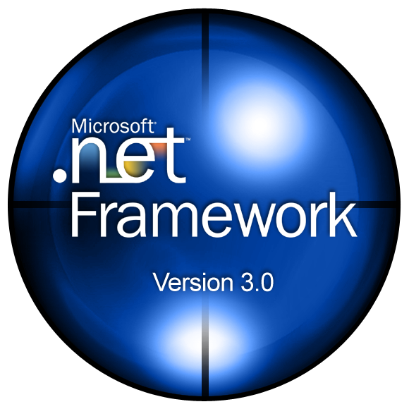


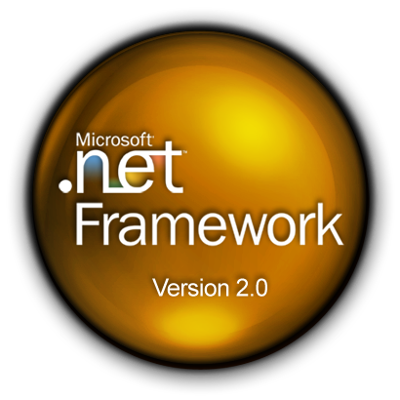



Microsoft .NET Framework 3.0
The Managed Code
Programming Model
for Windows

Slide 36
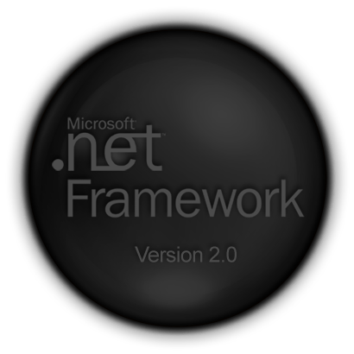

Windows Communication Foundation
Unified framework for
rapidly building
service-oriented applications

Slide 37









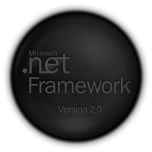


Windows Communication Foundation
Unified framework supersets existing technologies
ASMX
Remoting
Interop with
other platforms
Location
transparency
WSE
WS-* protocols
Attribute Based Programming
Notes:
3/5/2014 2:13 PM
37
© 2004 Microsoft Corporation. All rights reserved.
This presentation is for informational purposes only. Microsoft makes no warranties, express or implied, in this summary.
Next Generation Business Solutions Platform Strategy Review

Slide 38
Our Solution: Programming WCF
Classes added to the .NET Framework 2.0
… for building software services:
i.e. software designed for interaction over
a network with an interface described in WSDL.
WSDL is as important to software as money is
to the economy: it makes interactions efficient.
The WCF programming model follows WSDL closely.

Slide 39

Our Solution: Programming WCF
 |  | WSDL Section
a. | Where? | service
b. | How? | binding
c. | What? | portType

Slide 40
Our Solution: Programming WCF
 |  | WSDL Section | WCF Term
a. | Where? | service | address
b. | How? | binding | binding
c. | What? | portType | contract
Specified in a configuration file
A .Net interface and implementation

Slide 41
Our Solution: WCF Architecture
User Code
User Code
Typed Proxy
Dispatcher
Protocol
Protocol
Encoding
Encoding
Transport
Transport
Message
Notes:
WCF architecture defined and explained in the context of the previous demo to provide concrete definition/example how messages are passed and communication managed.
Typed proxy– uses code and configuration to determine what the communication channel should look like. Creates a Message object (.NET representation of SOAP message) and passes it through the channels to be communicated to the service.
Protocol – where we find the WS-* implementations or custom protocols to be used by both client and service.
Encoding – where the message is encoded as a specific text or binary format.
Transport – responsible for sending the encoded message over the wire.
Dispatcher – converts SOAP message back to .NET and calls the service code written by the developer.
All of these components can be swapped out with custom implementations to meet the needs of an ISV or enterprise. Even the Typed Proxy and Dispatcher can be replaced if needed.

Slide 42

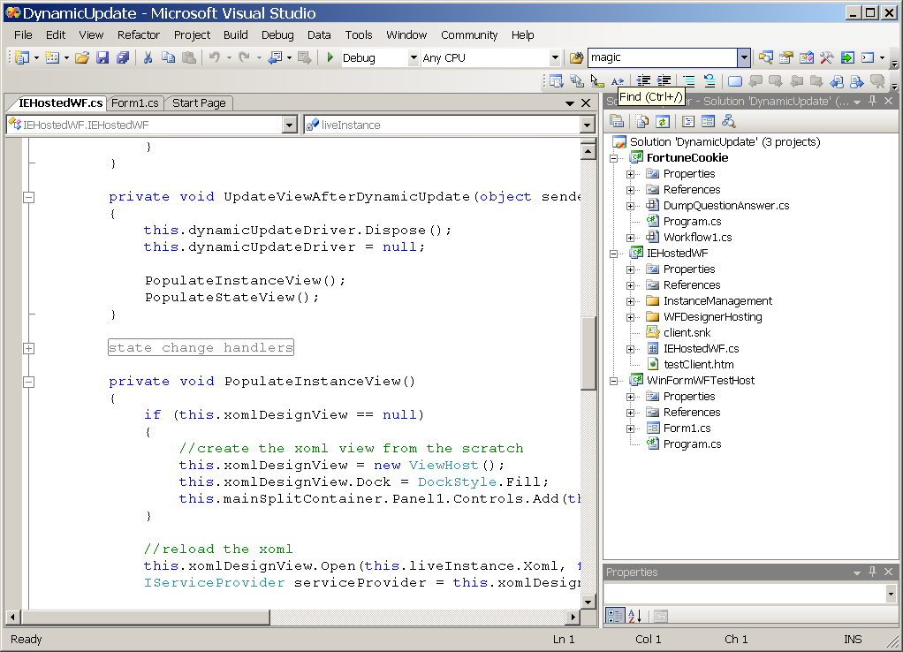
WCF Live Coding
Notes:
42

Slide 43
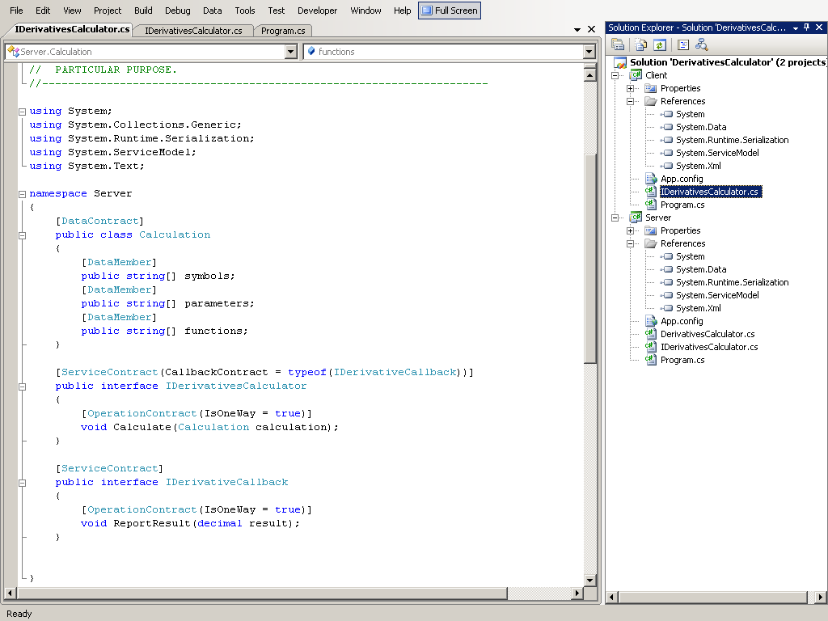

Slide 44
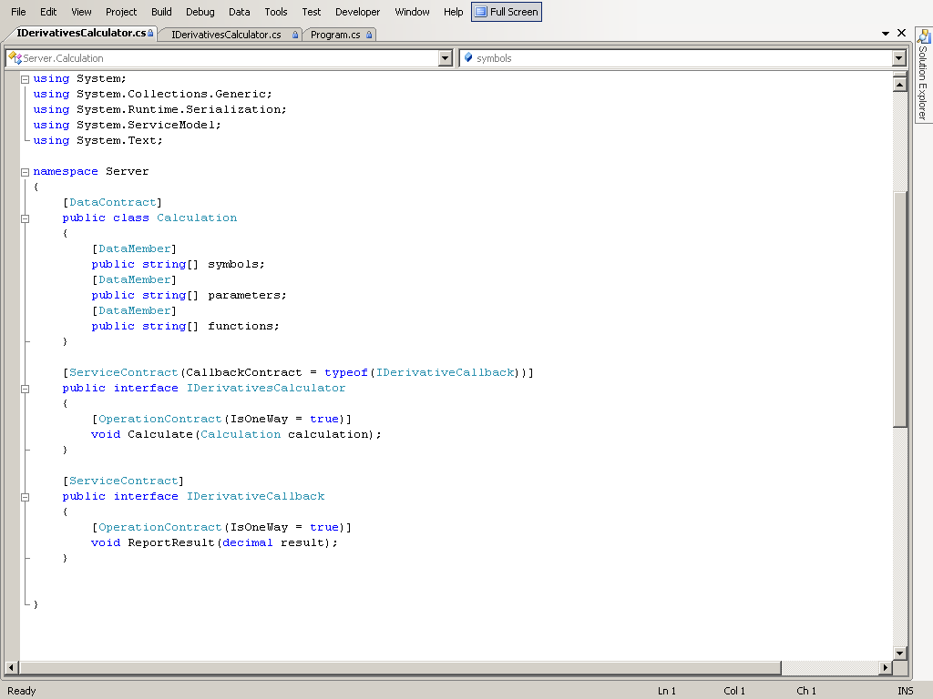

Slide 45
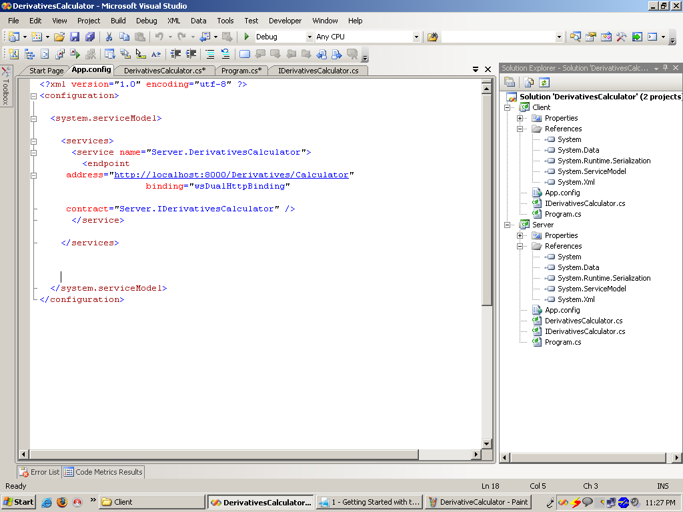
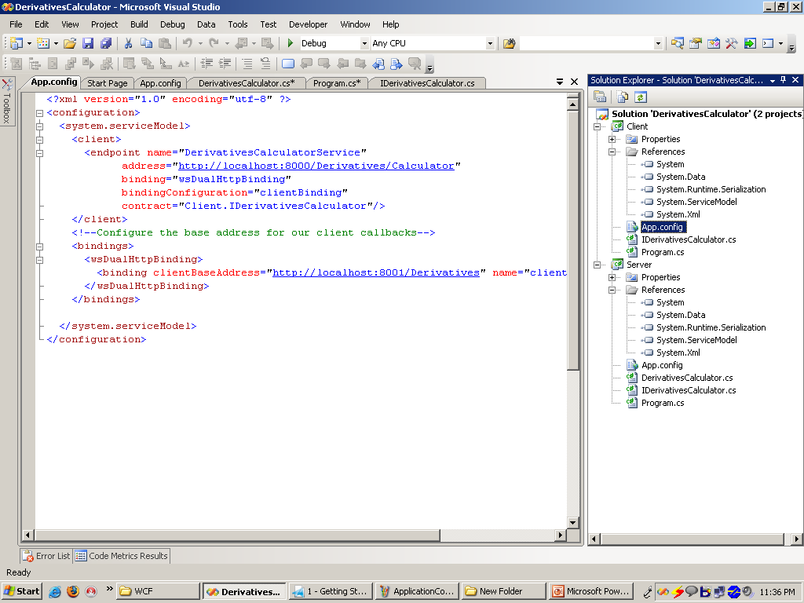
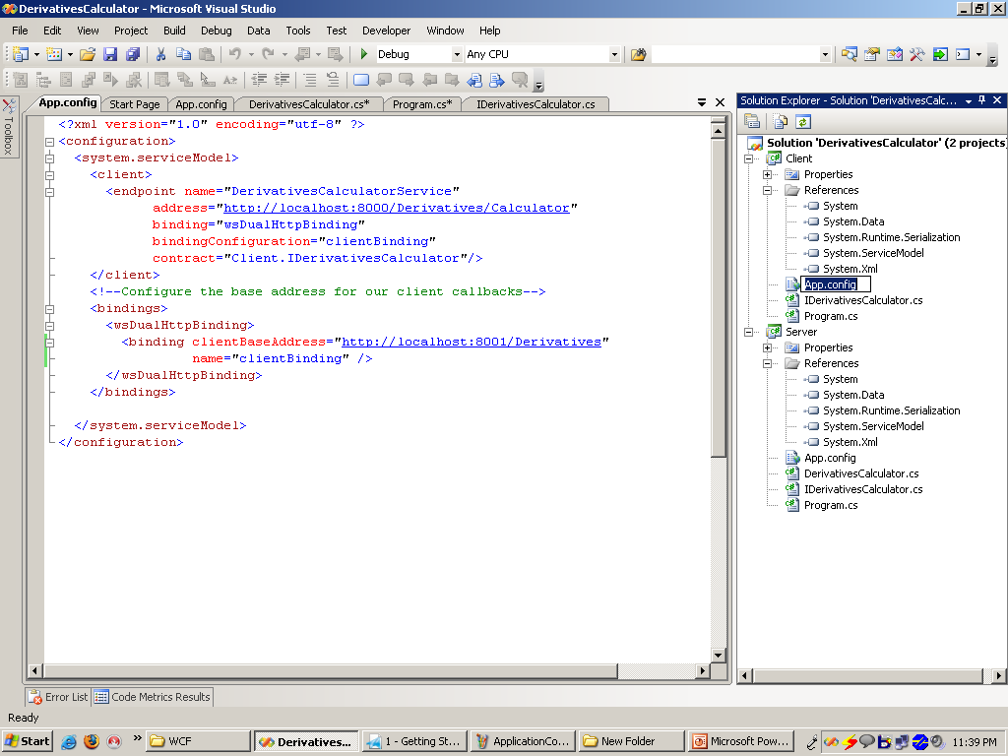

Slide 46
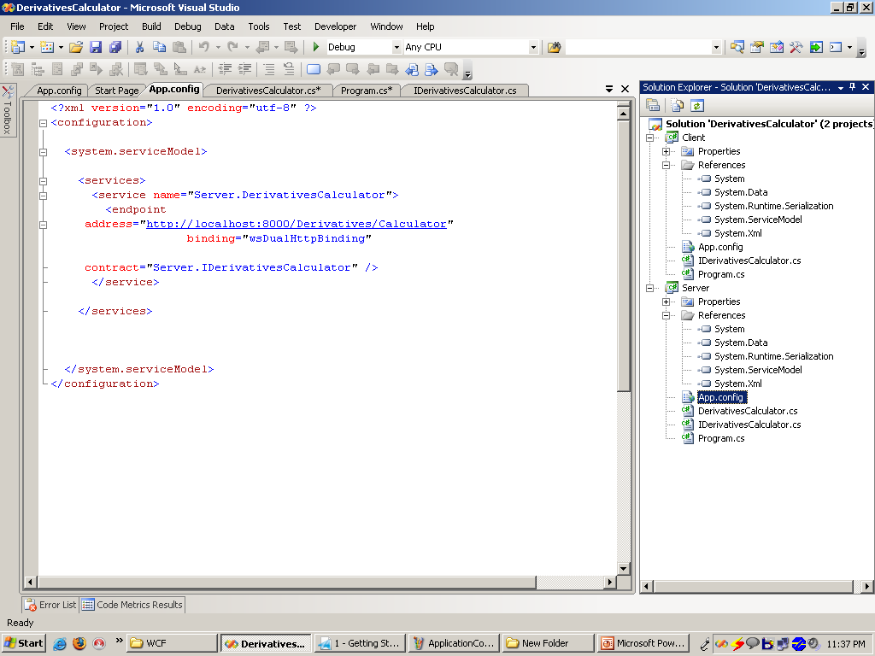

Slide 47
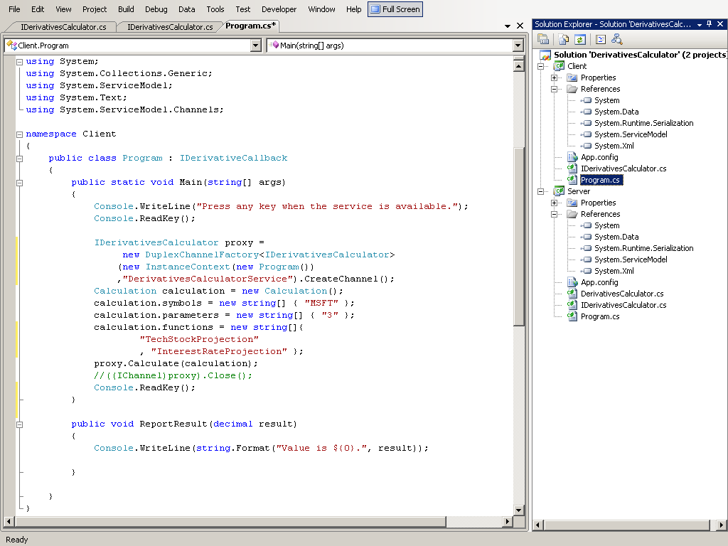

Slide 48
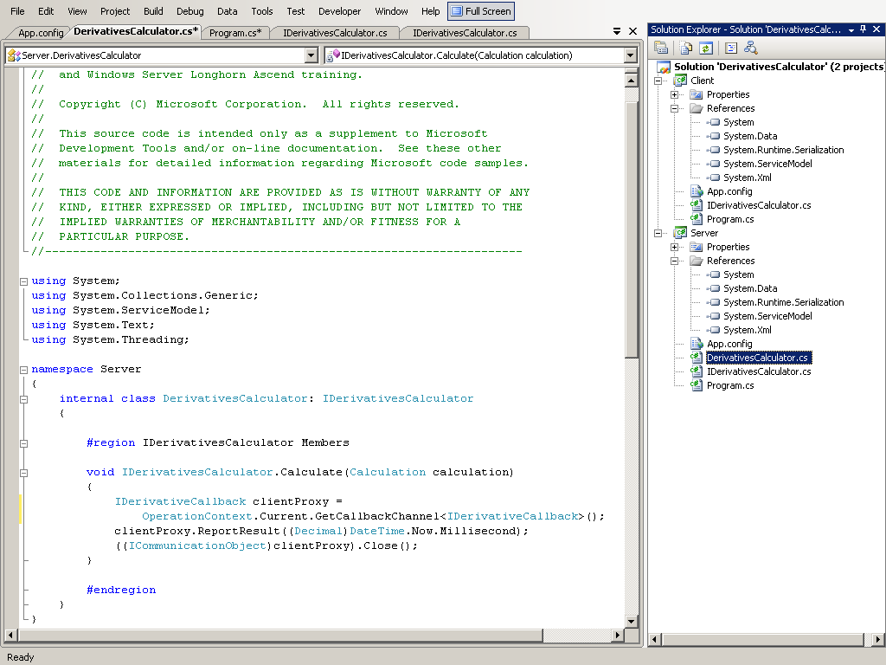

Slide 49
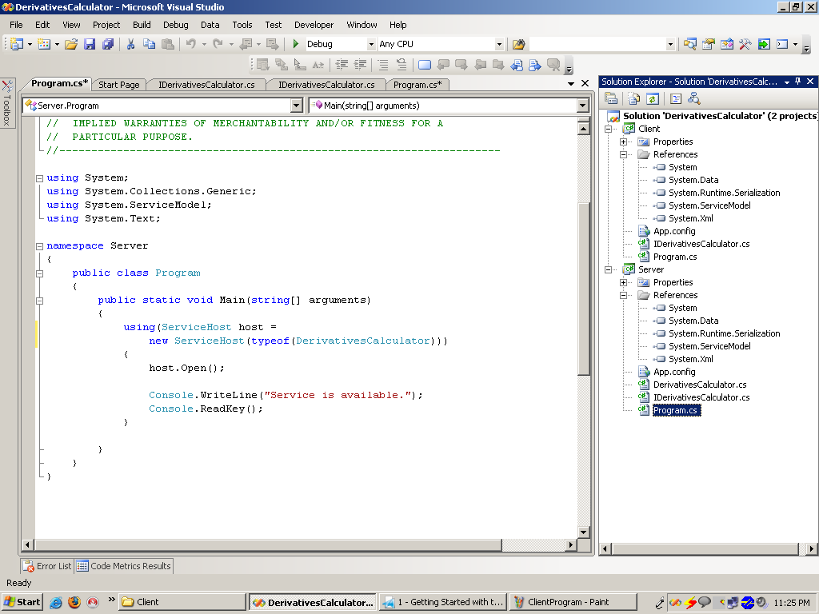

Slide 50
Windows Workflow Foundation
Programming model, engine
and tools for building
workflow-enabled applications

Slide 51




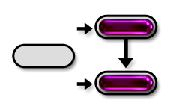
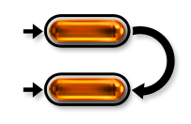
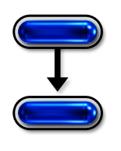
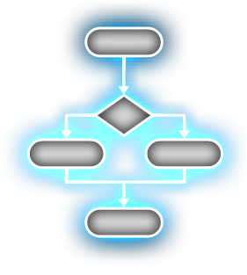
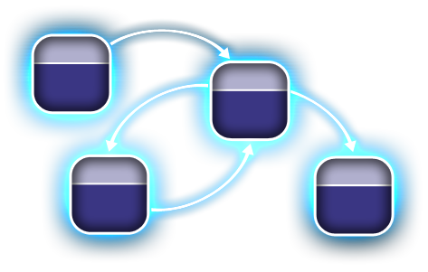
What Is A Workflow?
A Set Of Activities
That Coordinates People
And / Or Software...
Sequential
Workflow
Rules-driven
Activities
State Machine
Workflow
EX: Escalate To Manager
EX: Check Inventory
Rule1
Step1
Event
State1
Like a flowchart….
Step1
Sequential structure
Prescribes processing order
Or a state diagram….
Data
Event
State2
Rule2
Step2
Step2
Rules + data state drive processing order
External events drive processing order

Slide 52

Windows Workflow Foundation
Visual Designer
Key Concepts
Workflows are a set of Activities
A Workflow
Workflows run within a Host Process: any application or server
Developers can build their own Custom Activity Libraries
An Activity
Custom Activity Library
Components
Windows
Workflow Foundation
Base Activity Library: Out-of-box activities and base for custom activities
Runtime Engine: Workflow execution and state management
Base Activity Library
Runtime Services: Hosting flexibility and communication
Runtime Engine
Visual Designer: Graphical and code-based construction
Runtime Services
Host Process
Notes:
Use forms/controls analogy here
Instead of visual controls on a presentation form, activities are non-visual elements hosted on a workflow.
Workflow types themselves (sequential and state machine) are just activities themselves which control the execution of the contained activities.
Mention a few activities that are included out of the box such as if/else or invoke web service to emphasize the different types of activities that exist.

Slide 53



Workflow Authoring Modes
Markup Only
“Declarative”
Markup and
Code
Code Only
Application
Generated
XAML
XAML
C#/VB
C#/VB
App creates activity
tree and serializes
XML defines
workflow structure
logic and data flow
XML defines
workflow
Code-beside
defines extra logic
Code creates
workflow
in constructor
XAML
C#/VB
Workflow Compiler
wfc.exe
.NET assembly
ctor defines
workflow
C#/VB Compiler
Notes:
Talk about the various authoring models and that other tools can be used to author workflows either in code or using markup or a combination of both.
Wfc.exe performs the validation of the workflow definition and the various activities to make sure they are being used properly.
Point out that in addition to the wfc.exe, there is an WorkflowCompiler class that can be used to compile in memory as well.
The XAML only option provides the flexibility many people are looking for but has some limitations which are talked about on the WF day.
NOTE: the upcoming expense report demo will show editing in XOML/CS

Slide 54
What are Activities?
An activity is a step in a workflow
Has properties and events that are programmable within your workflow code
Has methods (e.g. Execute) that are only invoked by the workflow runtime
Think of Forms & Controls
Activity == Controls
Workflows == Forms
Activities fall under two broad categories
Basic – steps that “do work”
Composite – manage a set of child activities
Notes:
In its simplest definition, an activity is a step or unit that represents runtime logic in a workflow. An activity can expose properties and events that can be programmed against within a workflow. An activity can also contain methods that are invoked by the workflow designer or workflowRuntime.
Activities are very similar to controls that are found in other areas of the .NET framework, such as WinForm or ASP.NET controls.
Activities fall under two broad categories:
- Basic or sometimes called Primitive activities, which are steps in a workflow that execute runtime logic
- composite – which manage a set of child activities
Drives on the point that WF is a framework and not a workflow language
A programming model and an embeddable execution framework for authoring and executing long running (asynchronous and stateful) workflow applications
Workflows can be written directly using Code OR Markup or a mix of both
Activities are the equivalent of controls for workflow. Workflows can be thought of as Forms. Workflows have a certain level of parental control and responsibility for their children.
Activities are the building blocks for workflow.
---------------------------
Unit of reuse → Just like a winforms control
Root activities are simply composite activities
Workflow consists of Activities
An activity is just a class – with a set of properties, methods, and events
Properties and events that are exposed to the outside world.
can be programmed from the workflow.
Supports pre/post interception hooks into execution in user code
Methods which implement the inner behavior and are called by the workflow runtime.
Activities fall within two broad categories:
Basic – Basic activities are steps that “do work”
Composite - composite activity manages the execution of a collection of child activities
In fact, a workflow itself is an activity. One variant of composite activites is a root activity.
Workflows are just a special kind of composite activity
This comes back to the point that WinWS provides a workflow framework and not a workflow language.
Custom activities provide the ability to implement your own custom workflow patterns and reuse them across workflows.
Activity is the basic building block

Slide 55








Activities: An Extensible Approach
Base Activity
Library
Custom Activity Libraries
Domain-Specific Workflow Packages
Compliance
CRM
Compose
activities
Extend
activity
Out-of-Box
Activities
Author new
activity
RosettaNet
IT Mgmt
OOB activities, workflow types, base types
General-purpose
Activity libraries define workflow constructs
Create/Extend/ Compose activities
App-specific building blocks
First-class citizens
Vertical-specific activities & workflows
Best-practice IP & Knowledge
Notes:
On this slide, talk to the fact that while there are built in activities, there are opportunities for developers to create their own libraries through extension (beta 2) or by creating new composite or basic activities.
The goal is that there will be vertical and horizontal packages of activities created by ISVs to provide an enormous amount of functionality to other developers.

Slide 56




Flexible Control Flow
Sequential Workflow
State Machine Workflow
Sequential
structure
prescribes
processing order
External
events drive
processing
order
Step1
Event
State1
Step2
Event
State2
Prescriptive, formal
Automation scenarios
Flowchart metaphor
Reactive, event-driven
Skip/re-work, exception handling
Graph metaphor
Rules-driven Activities
Rule1
Step1
Rules + data state
drive processing
order
Data
Rule2
Step2
Data-driven
Simple Conditions, complex Policies
Constrained Activity Group
Notes:
Talk about how these are the v1 options (sequential and state machine being the formal types) but that these are extensible for anyone to add custom types.
This material does not cover the rules driven activities, so it is good to give mention to them here and then more during the specific talks on activities.

Slide 57
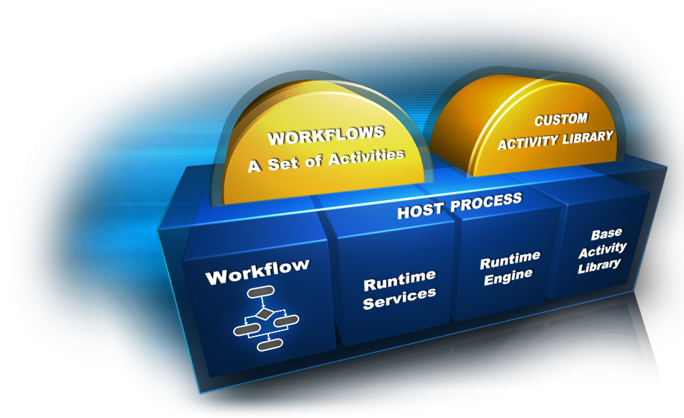
Windows Workflow Foundation
Notes:
57

Slide 58
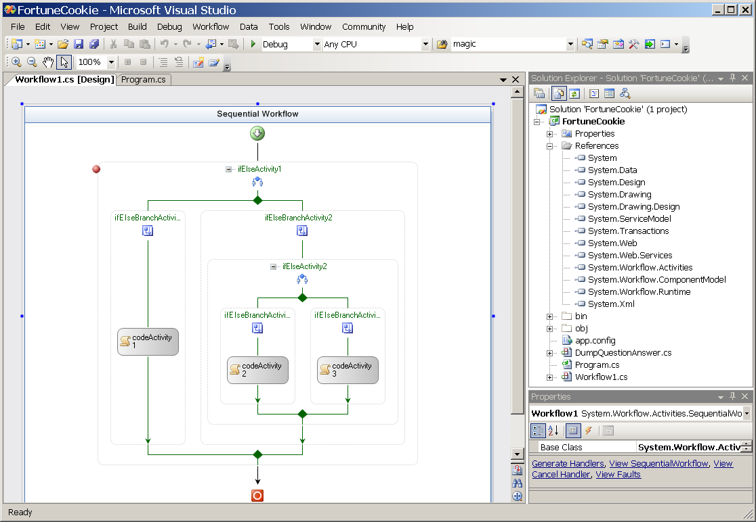
WF Live Coding
Notes:
The XOML language underneath is actually the same language as XAML. The only difference is the elements that are put into it. XOML uses node element names, which are similar to WPF, but in XOML they are associated with processes, rather than the buttons and interface elements found in XAML. In addition, XOML uses a different file extension, .xoml, so as not to confuse applications trying to open them up as interface elements
58

Slide 59
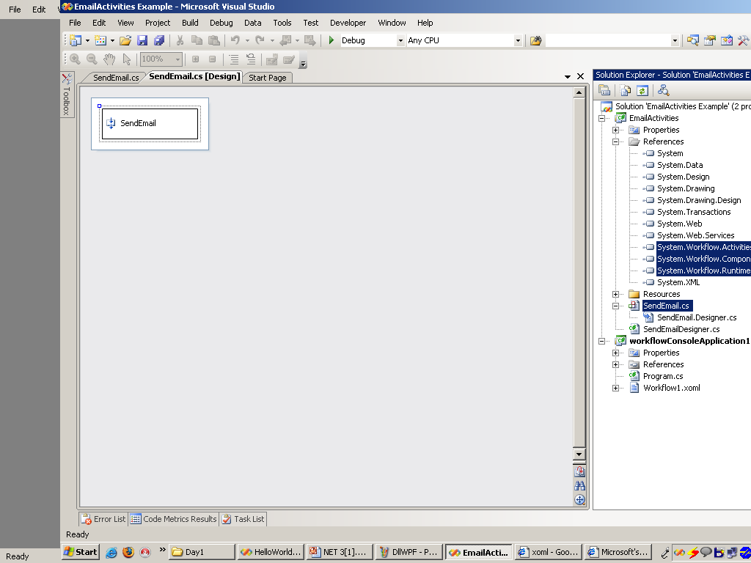
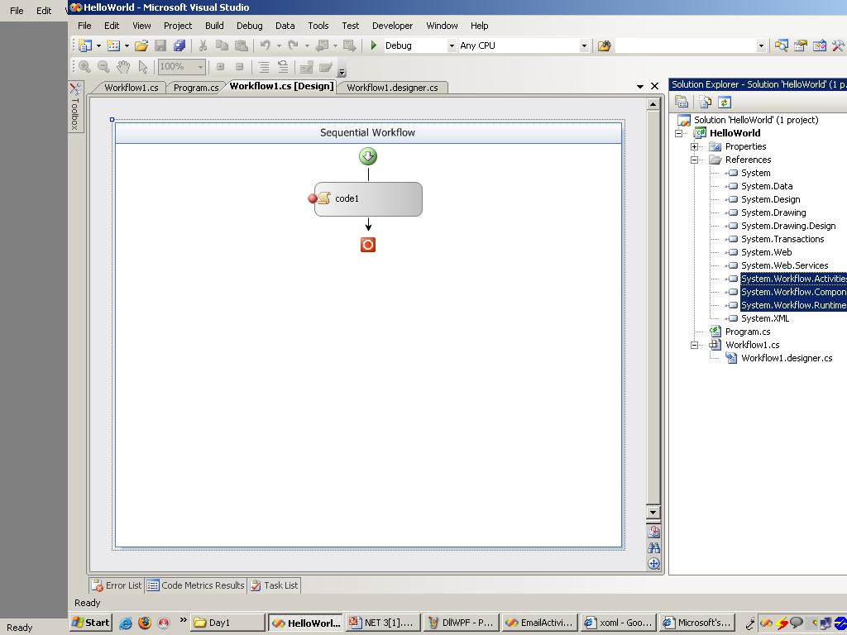

Slide 60
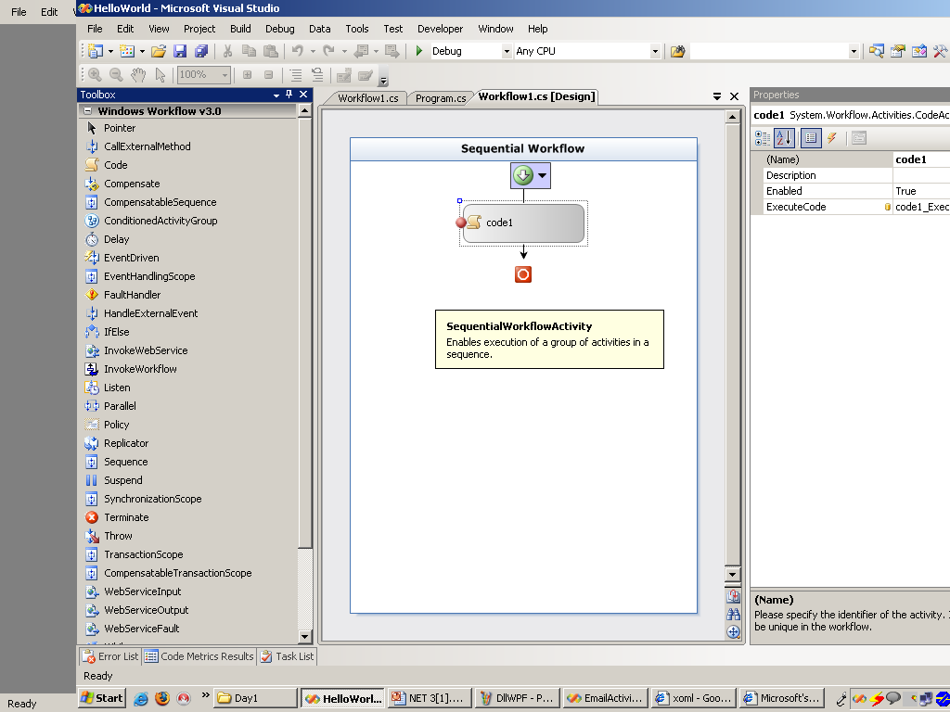

Slide 61
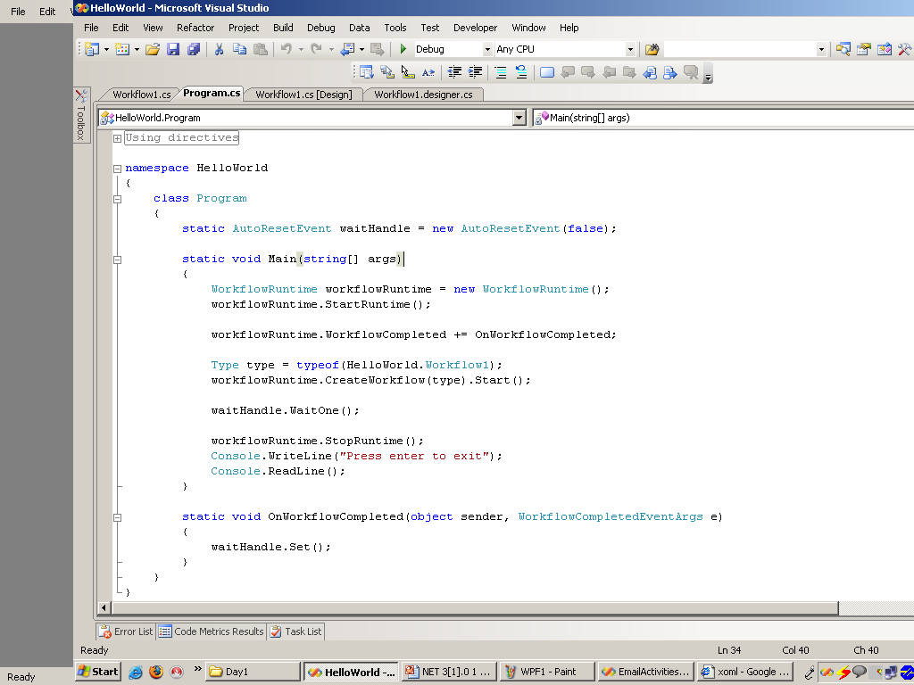

Slide 62
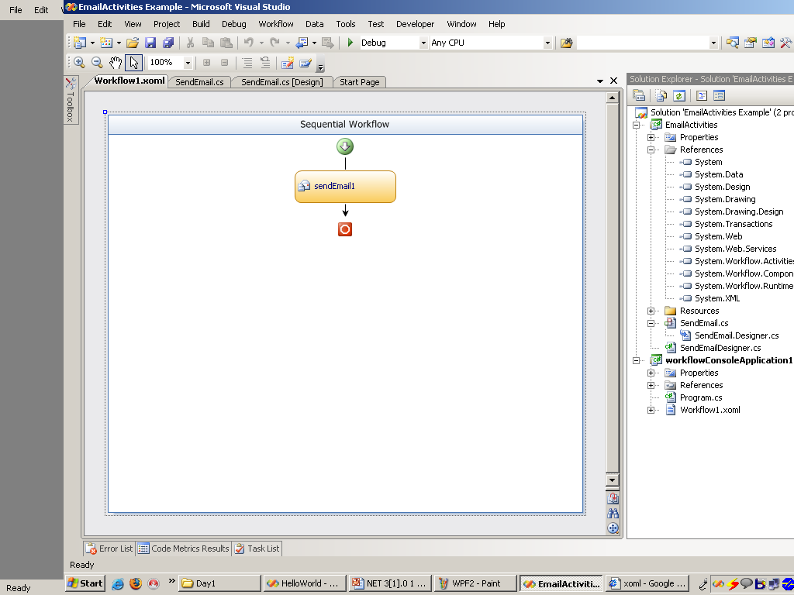

Slide 63
Windows Presentation Foundation
Unified framework for building
next gen user experiences with
UI, media and documents

Slide 64



Windows Presentation Foundation
XAML
extensible Application Markup Language
C#
XAML
VB.NET
Button b1 = new Button();
b1.Content = "OK";
b1.Background = new SolidColorBrush(Colors.LightBlue);
b1.Width = 100;
<Button Width="100"> OK
<Button.Background>
LightBlue
</Button.Background>
</Button>
Dim b1 As New Button
b1.Content = "OK"
b1.Background = New _ SolidColorBrush(Colors.LightBlue)
b1.Width = 100
Notes:
64

Slide 65


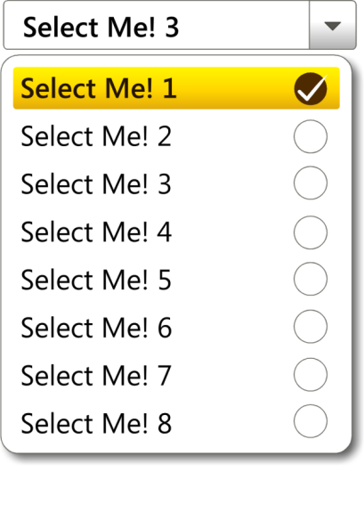
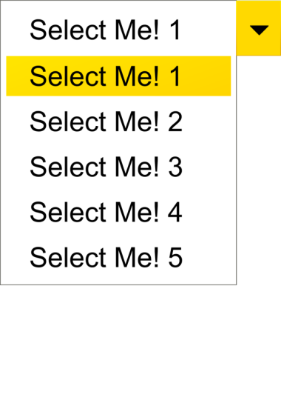



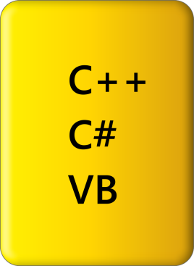

Windows Presentation Foundation
With XAML designers & developers can streamline their collaboration
Notes:
65

Slide 66
What is WPF?
Windows Presentation Foundation is one of four principal components in .NET 3.0
WPF is essentially an alternative method for developing Windows based applications
Notes:
3/5/2014 2:13 PM
66
© 2004 Microsoft Corporation. All rights reserved.
This presentation is for informational purposes only. Microsoft makes no warranties, express or implied, in this summary.
Next Generation Business Solutions Platform Strategy Review

Slide 67
WPF vs Windows Forms Development
WPF has a number of advantages over Windows Forms development which include
Comprehensive Integration – WPF provides a uniform platform for using video, speech, text, 2D and 3D graphics
Resolution Independence – as DPI increases, WPF applications maintain their size exactly
Instead of shrinking, WPF applications merely get Sharpe

Slide 68
WPF Advantages over Windows Forms Development
WPF supports hardware acceleration
WPF applications can take advantage of GPUs on Graphics cards for smoother graphics
WPF allows the effective separation of design work (to be performed by Designers) and functionality (to be performed by Developers)

Slide 69
WPF Advantages over Windows Forms Development
WPF supports a new model for content under which almost any control can host almost any other control
This permits very rich user interfaces as almost any control can support 3D graphics, animations and even videos
WPF supports almost complete scalability

Slide 70
WPF and XAML
XAML is a declarative programming language designed for constructing and initializing .NET objects
XAML code is principally the textual representation of some visual element – either a graphic object or a user interface object such as a button or a combo box

Slide 71
WPF and XAML
Under the standard paradigm the User Interface is described in XAML and the underlying functionality is built using C# (or Visual Basic .NET)
However, using Markup Extensions Microsoft has cleverly been able to build a considerable degree functionality into XAML
Usually when things can be expressed in either C# or XAML, XAML is more terse

Slide 72
What is WPF/E
WPF/E stands for WPF Everywhere
WPF/E is basically a Microsoft equivalent for Macromedia Flash
Currently only in beta form, WPF supports Fire fox and Internet Explorer 7 on Windows and Fire fox and Safari on the MAC

Slide 73
What is the Relationship Between WPF/E and WPF
WPF/E uses a Javascript control to host content created using XAML
Recall that vector graphics can be expressed in XAML and that WPF has very strong support for animations
Client side event handling is processed using JavaScript

Slide 74
What is the Expressions Suite
The Expressions Suite consists of four designer type applications
Only one of these applications, Expressions Web Designer has been officially released (January, 2007)
The other three releases are currently in beta release (or CTP)

Slide 75
Expressions Web Designer
This product is essentially the successor to Microsoft Front Page
Its principal competitor is Macromedia (Adobe) DreamWeaver
The emphasis by Microsoft for this product is Standards Based web design (XHTML)
This product has nothing at all directly to do with WPF

Slide 76
Expressions Blend
Expressions Blend is a Visual Studio like tool for designing WPF user interfaces
While Blend is intended for use by Designers, it is sufficiently superior to the equivalent designer in Visual Studio that most Developers will likely use it in conjunction with Visual Studio

Slide 77
Expressions Graphic Designer
This product represents Microsoft’s attempt to move into the space occupied by Adobe Illustrator and CorelDraw
Vector Graphics
Graphic Designer uses XAML as its native output language
This, of course, facilitates using these vector graphics in WPF applications

Slide 78
Expressions Media
The latest addition to the Expressions suite
Represents a content management system similar to Adobe Bridge
No direct relationship with WPF

Slide 79
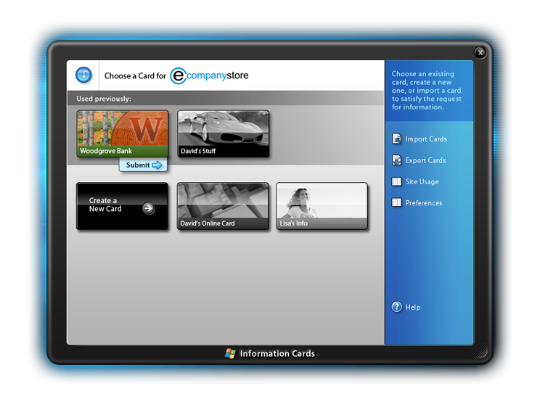
Windows CardSpace
Private desktop
Separate user context
Protects against hacking
Self-issued cards
Non-corroborated
Stored locally
Managed cards
Corroborated
Stored at STS

Slide 80






Windows CardSpace
WS-*
Web Services
User
Relying Party
Identity Provider
Notes:
3/5/2014
80
© 2004 Microsoft Corporation. All rights reserved. This presentation is for informational purposes only. Microsoft makes no warranties, express or implied, in this summary.

Slide 81
Introduction to Windows CardSpace
Windows CardSpace is client software that enables users to provide their digital identity to online services in a simple, secure and trusted way.
It is what is known as an identity selector
The CardSpace UI enables users to create Personal cards (aka self-issued cards) and associate a limited set of identity data.

Slide 82
Windows CardSpace
The architecture upon which CardSpace has been built – consisting of subjects, identity providers and relying parties – is called “The Identity Metasystem”.

Slide 83
Microsoft .NET Framework 3.0
Windows Presentation Foundation
Next generation user experience
Windows Communication Foundation
Service-oriented development
Windows Workflow Foundation
Business process modeling
“CardSpace”
Digital identity management
Notes:
3/5/2014 2:13 PM
83
© 2004 Microsoft Corporation. All rights reserved.
This presentation is for informational purposes only. Microsoft makes no warranties, express or implied, in this summary.
Next Generation Business Solutions Platform Strategy Review

